Slide 1

F O R P U R P O S E S O F F O R A G E V I R T U A L W O R K E X P E R I E N C E P R O G R A M
B Y : Manoj Kumar Reddy Mule
N o v e m b e r 2 0 2 4

Slide 2
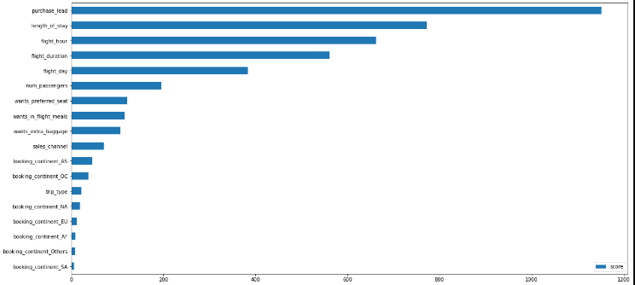
R E S U L T
From our feature importance from our model, we know that the influencing factors for customers to complete their bookings are purchase_lead (namely the time gap between the order time and the flight) and length_of_stay (namely how long the customer will occupy the destination).
Then the area where the customer orders does not affect whether the customer will complete the booking or not
FOR PURPOSES OF FORAGE VIRTUAL WORK EXPERIENCE PROGRAM
2

